Slide 1
Effect of 2 types of antihypertensive therapy
on cognition and vessel wall
To feed the flame!
L. Csiba
Department of Neurology, Debrecen University
Hungary
Belgrad, ESNCH, 17th of October, 2021

Slide 2
Stroke risk factors
35%
HT
%frequency
Hyperlipidemia
27%
Smoking
27%
27%
2025-----1,6 Mrd HT
30% of world population
Inaktivity
Obesity
18%
Carotid stenosis
4%
AF
2%
Realative risk
Alberts. Curr Med Res Opin 2003;19:438–441
Notes:
Hypertension is one of the most prevalent modifiable risk factors for stroke.
It markedly increases the level of risk.
Therefore, improving blood pressure in individuals at risk of stroke is likely to have beneficial effects.
Alberts MJ. Update on the treatment and prevention of ischaemic stroke. Curr Med Res Opin 2003;19:438–441.

Slide 3
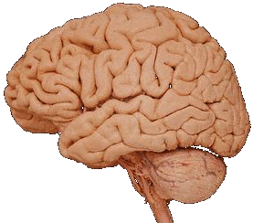
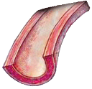
The effect of risk factors
Memory and attention deficit
Vascular remodelling
cardio- és cerebrovascular complications
LVH
Fibrosis
Remodelling
Apoptosis
↓ Glomerular filtration Proteinuria/albuminuria
Glomerulosclerosis
↑ Aldosterone
Vasoconstriction
Vascular hypertrophy
Endothel dysfunction
Atherosclerosis
Notes:
Hypertension induces target-organ damage, leading to an increased risk of stroke, cardiovascular disease and renal failure.¹ Antihypertensives, such as telmisartan (an ARB), can reduce the risk of these outcomes.
In addition to its effects on blood pressure, angiotensin II also exerts a wide variety of deleterious effects on target organs that can hasten end-organ damage.² These effects are mediated directly or via several signal transduction pathways that lead to cellular proliferation, increased oxidative stress and reduced nitric oxide.²
Therefore, interventions that target the RAAS can have benefits in addition to their effects on hypertension.
Whitworth JA. 2003 World Health Organization (WHO)/International Society of Hypertension (ISH) statement on management of hypertension. J Hypertens 2003; 21(11):1983–1992.
Willenheimer R, et al. AT₁-receptor blockers in hypertension and heart failure: clinical experience and future directions. Eur Heart J 1999;20:997–1008.

Slide 4
1. Hypertension and cognition?

Slide 5
HT & cognitive function
⬇ attention Madden & Blumenthal, 1998
⬇learning and memory P. K. Elias, 1997
⬇visuospatial functions

Slide 6
2. Our previous observations

Slide 7
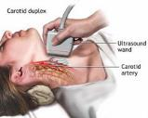
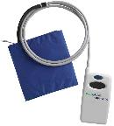
Methods
1. ABPM
2. IMT
5. Cognition

Slide 8
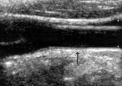
Kovács KR..Csiba L. J Am Soc Hypertens. 2014 Aug;8(8):550-60.

Slide 9
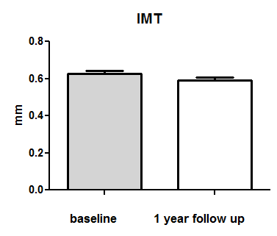
Improvement of the sum of IMT
after 1 year anti-HT therapy
0.63±0.11
p=0.0003
0.59±0.10
N=47
Bajkó Z…Csiba L. J Neurol Sci. 2012 Jun 15;317(1-2):112-6.

Slide 10
Cognitive tests
Tests
Reaction time (sec.)
Selective reaction time (sec.)
Rey verbal learning (no.)
Recognition (no.)
Pieron test (%)
Digit connection (sec)
Digit recall (no.)
Mozaic test (sec.)
Digit symbol test (no.)
Notes:
A neuropszichológiai tesztek eredményét szintén táblázatba foglaltam. És itt látható, hogy főleg a rövidtávú memóriát és figyelmet felmérő tesztek során teljesítettek jobbana betegek egy év után. A tesztek eredményét összeítő score is jelentősen jobb volt, ami azt tükrözi, hogy a betegek kognitív funkciója összességében jobb. A szorongás mértéke pedig jelentősen csökkent a betegek körében.

Slide 11
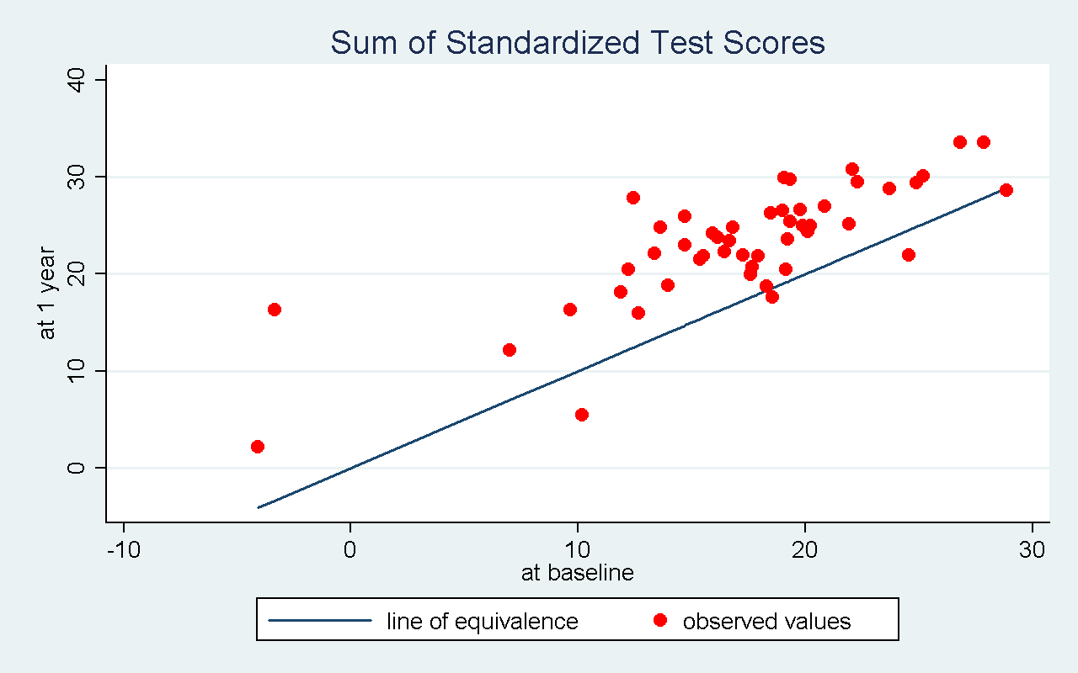
Improvement of the sum of cognitive tests
after 1 year anti-HT therapy
p <0.0001
Csikai E..Csiba L. Medicine (Baltimore). 2019;98(34):e16966.
Czuriga-Kovács..Csiba L.. CNS Neurol Disord Drug Targets. 2016;15(6):690-8.
Notes:
Ezen az ábrán látható az, hogy azon betegek akik az ekvivalencia vonal fellett helyezkednek el jobban teljesítettek egy év után.

Slide 12
New questions on HT pts.
3 mo period of ACE therapy?
IMT?
FMD?
Arteriograph/stiffness?
Cognition?
Correlation between BP decrease and cognition?
3 mo Enalapril vs lisinopril?

Slide 13
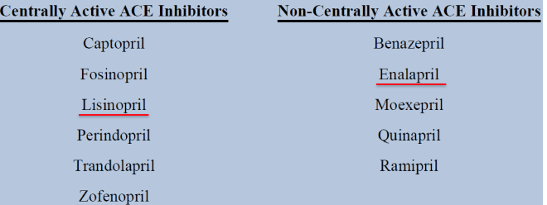
Enalapril vs lisinopril?

Slide 14
Recently diagnosed, non-treated asymptomatic HT patients n=105
3 months later
Baseline

Slide 15
After
3 months
Inclusion
Start of
pharmacoth.
ACE-I:
enalapril or
lisinopril
0. day
- HT diagosis
- anamnesis
neurol.exam.
labs
CT
ABPM
time
-Labs
ABPM
neuropsych. tests
IMT
stiffness
FMD
neuropsych. tests
IMT
Arterial stiffness
FMD

Slide 16
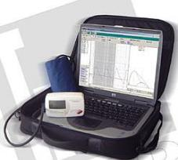
Methods
1. ABPM
2. IMT
3. Flow mediated dilation
4. Arterial stiffness
5. Cognition
5.1.Complex attention and react. time 5.2.Executive functions 5.3.Immediate memory 5.4.Anxiety and depression
arterial stiffness: - PWV (aorta)

Slide 17
ABPM after 3 months ACE-therapy
1. ABPM

Slide 18
IMT after 3 months ACE-therapy
2. IMT
0.55±0.10 0.54±0.08 mm p=0.1249

Slide 19
FMD after 3 months ACE-therapy
Flow mediated dilation
7.5% ±02.2 8.1%±2.6 p=0.39

Slide 20
Arterial stiffness after 3 months ACE-therapy?
4. Arterial stiffness
-arterial stiffness - PWV (aorta)

Slide 21
Arterial stiffness

Slide 22
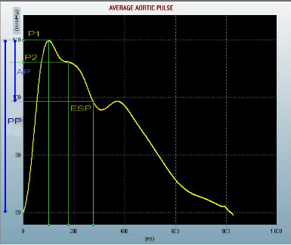
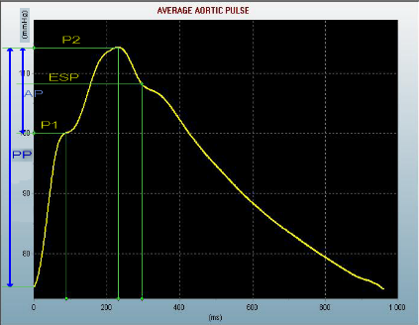
Vessel stiffness Augmentation index (AIx)
Normal
Affected
Augmentation index
P2-P1/ PP
P2 < P1 (negative values)
Augmentation index
P2-P1/ PP
P1 < P2 (positive values)

Slide 23
Arterial stiffness after 3 months ACE-therapy
Augmentation index -17.5±34.4 –32.1±34.3 p=0.08
Pulse wave vel. 9.3±2.4 9.0±2.0 p=0.14
-arterial stiffness - PWV (aorta)

Slide 24
Cognitive domains and psychological inventories:common group of enalapril and lisinopril
 | p value (baseline and 3 month follow up)
1.Complex attention and reaction time (overall score) | 0.0738
2.Executive functions (overall score) | 0.0010
3.Immediate memory (overall score) | 0.8118
Spielberger State Anxiety Inventory (score) | 0.0155
Spielberger Trait Anxiety Inventory (score) | 0.0766
Beck Depression Inventory (score) | 0.0306

Slide 25
Enalapril vs lisinopril?

Slide 26
ABPM SBP (Mean difference:before-after)
p=0.002

Slide 27
ABPM DBP (Mean difference:before-after)

Slide 28
FMD (Mean difference:after-before)

Slide 29
Learning (Mean difference:after-before)
p<0.001
p=0.075

Slide 30
Summary of 3 mo ACE-I therapy
If you mix the results of lisinopril or enalapril:
no effect on the IMT and FMD
Minor changes in vascular stiffness
Some domains of cognition improved

Slide 31
Enalapril (centrally not active) vs lisinopril (centrally active)
Both drugs decreased the BP
Enalapril improved the FMD, but the lisinopril did not!
Enalapril (centrally NOT active!) has improved the learning tests
The lisinopril (centrally active) did not improve significantly the the learning tests.
Minor changes in vascular stiffness
Some domains of cognition improved

Slide 32
Summary
The possible positive effect of antihypertensive therapy on cognition is mediated by the BP decreasing effect, not by the direct effect of anti-HT drug on the CNS.
Minor changes in vascular stiffness
Some domains of cognition improved

Slide 33
Thank you!

